Slide 1





SMART WASTE MANAGEMENT USING IBM WATSON SERVICES
TEAM MEMBERS :
A.MAHALAKSHMI
B.JYOTHI
CH.AMRUTHA VALLI

Slide 2
INTRODUCTION
The concept of smart waste management is implementable
in cities where waste production is domestically high
but the effort put to control it is relatively very low.
This idea is compatible mainly with the concept of
smart cities. The smart waste management mainly avoids
the congested collection of waste generated domestically
which creates difficulty to manage its disposal.

Slide 3
OBJECTIVE
Smart waste management is a idea where we can control lots
of problems which disturbs the society in pollution and
diseases. The waste management has to be done
instantly else it leads to irregular management which
will have adverse effect on nature. The Smart waste
management is compatible mainly with concept of
smart cities. The main objectives of our proposed
system are as follows: 1. Monitoring the waste management.
2. Providing a smart technology for waste system.
3. Avoiding human intervention.
4. Reducing human time and effort
5. Resulting in healthy and waste ridden environment.

Slide 4
COMPONENTS REQUIRED
HARDWARE COMPONENTS:
Ultrasonic sensor
Node MCU-Wifi module-8266
Jumper Wires
SOFTWARE COMPONENTS:
Aurdino IDE
IBM Cloud Watson Platform

Slide 5
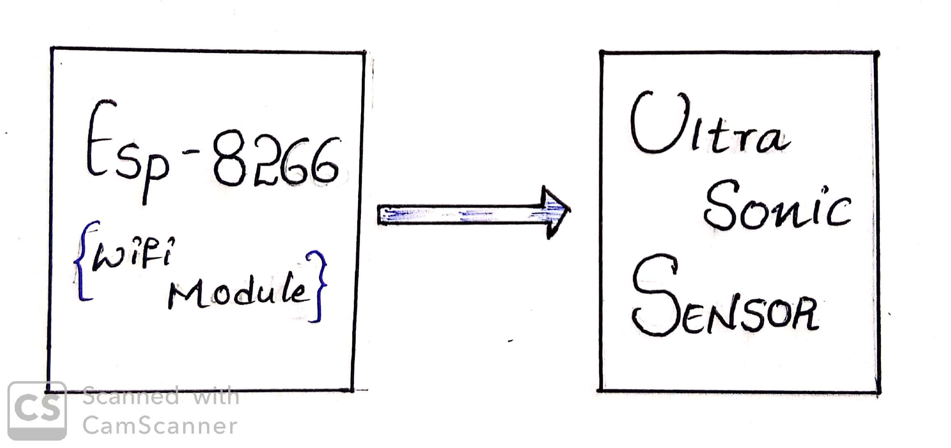
BLOCK DIAGRAM

Slide 6


